Slide 1
Chapter 6:Design rules and implementation support Design rules
Designing for maximum usability – the goal of interaction design
Design rules have two dimensions
– rule’s authority - an indication of whether or not the rule must be followed in design or whether it is only suggested.
– generality - whether the rule can be applied to many design situations or whether it is focused on a more limited application situation.
Principles of usability - general understanding
Standards and guidelines - direction for design
Design patterns - capture and reuse design knowledge

Slide 2
Types of design rules
principles
abstract design rules
low authority
high generality
standards
specific design rules
high authority
limited application
guidelines
lower authority
more general application
increasing generality
increasing authority

Slide 3
Principles to support usability
Learnability
The ease with which new users can begin effective interaction and achieve maximal performance
Flexibility
The multiplicity of ways the user and system exchange information
Robustness
The level of support provided the user in determining successful achievement and assessment of goal-directed behaviour.

Slide 4
Principles of learnability
Predictability
Determining effect of future actions based on past interaction history.
Operation visibility.
Synthesizability
assessing the effect of past actions
immediate vs. eventual honesty

Slide 5
Principles of learnability (ctd)
Familiarity
How prior knowledge applies to new system.
guessability; affordance
Generalizability
Extending specific interaction knowledge to new situations.
Consistency
Likeness/eveness in input/output behaviour arising from similar situations or task objectives.

Slide 6
Principles of flexibility
Dialogue initiative
freedom from system imposed constraints on input dialogue
system vs. user pre-emptiveness
Multithreading
ability of system to support user interaction for more than one task at a time
concurrent vs. interleaving; multimodality
Task migratability
passing responsibility for task execution between user and system

Slide 7
Principles of flexibility (ctd)
Substitutivity
allowing equivalent values of input and output to be substituted for each other
representation multiplicity; equal opportunity
Customizability
modifiability of the user interface by user (adaptability) or system (adaptivity)

Slide 8
Principles of robustness
Observability
ability of user to evaluate the internal state of the system from its perceivable representation.
browsability; defaults; reachability; persistence; operation visibility
Recoverability
ability of user to take corrective action once an error has been recognized.
reachability; forward/backward recovery; commensurate effort

Slide 9
Principles of robustness (ctd)
Responsiveness
how the user perceives the rate of communication with the system
Stability
Task conformance
degree to which system services support all of the user's tasks
task completeness; task adequacy

Slide 10
Using design rules
Design rules
suggest how to increase usability
differ in generality and authority
increasing generality
increasing authority

Slide 11
Standards
Set by national or international bodies to ensure compliance by a large community of designers standards require sound underlying theory and slowly changing technology.
Hardware standards more common than software high authority and low level of detail.
ISO 9241 defines usability as effectiveness, efficiency and satisfaction with which users accomplish tasks,

Slide 12
Guidelines
more suggestive and general
many textbooks and reports full of guidelines
abstract guidelines (principles) applicable during early life cycle activities.
detailed guidelines (style guides) applicable during later life cycle activities.
understanding justification for guidelines aids in resolving conflicts.

Slide 13
Golden rules and heuristics
Useful check list for good design
Better design using these than using nothing!
Different collections e.g.
Nielsen’s 10 Heuristics
Shneiderman’s 8 Golden Rules
Norman’s 7 Principles
A heuristic evaluation is a usability inspection method for computer software that helps to identify usability problems in the user interface (UI) design.

Slide 14
Shneiderman’s 8 Golden Rules
1. Strive for consistency
2. Enable frequent users to use shortcuts
3. Offer informative feedback
4. Design dialogs to yield closure
5. Offer error prevention and simple error handling
6. Permit easy reversal of actions
7. Support internal locus of control
8. Reduce short-term memory load

Slide 15
Norman’s 7 Principles
1. Use both knowledge in the world and knowledge in the head.
2. Simplify the structure of tasks.
3. Make things visible: bridge the gulfs of Execution and Evaluation.
4. Get the mappings right.
5. Exploit the power of constraints, both natural and artificial.
6. Design for error.
7. When all else fails, standardize.

Slide 16
HCI design patterns
An approach to reusing knowledge about successful design solutions
Originated in architecture: Alexander
A pattern is an invariant solution to a recurrent problem within a specific context.
Examples
Light on Two Sides of Every Room (architecture)
Go back to a safe place (HCI)
Patterns do not exist in isolation but are linked to other patterns in languages which enable complete designs to be generated.

Slide 17
HCI design patterns (cont.)
Characteristics of design patterns
capture design practice not theory
capture the essential common properties of good examples of design
represent design knowledge at varying levels: social, organisational, conceptual, detailed
embody values and can express what is humane in interface design
are intuitive and readable and can therefore be used for communication between all stakeholders
a pattern language should be generative and assist in the development of complete designs.

Slide 18
Implementation support
programming tools
levels of services for programmers
windowing systems
core support for separate and simultaneous user-system activity
programming the application and control of dialogue
interaction toolkits
bring programming closer to level of user perception
user interface management systems
controls relationship between presentation and functionality

Slide 19
Introduction
How does HCI affect of the programmer?
Advances in coding have elevated programming
hardware specific → interaction-technique specific
Layers of development tools
windowing systems
interaction toolkits
user interface management systems

Slide 20
Elements of windowing systems
Device independence
programming the abstract terminal device drivers
image models for output and (partially) input
pixels
PostScript (MacOS X, NextStep)
Graphical Kernel System (GKS)
Programmers' Hierarchical Interface to Graphics (PHIGS)
Resource sharing
achieving simultaneity of user tasks window system supports independent processes isolation of individual applications

Slide 21
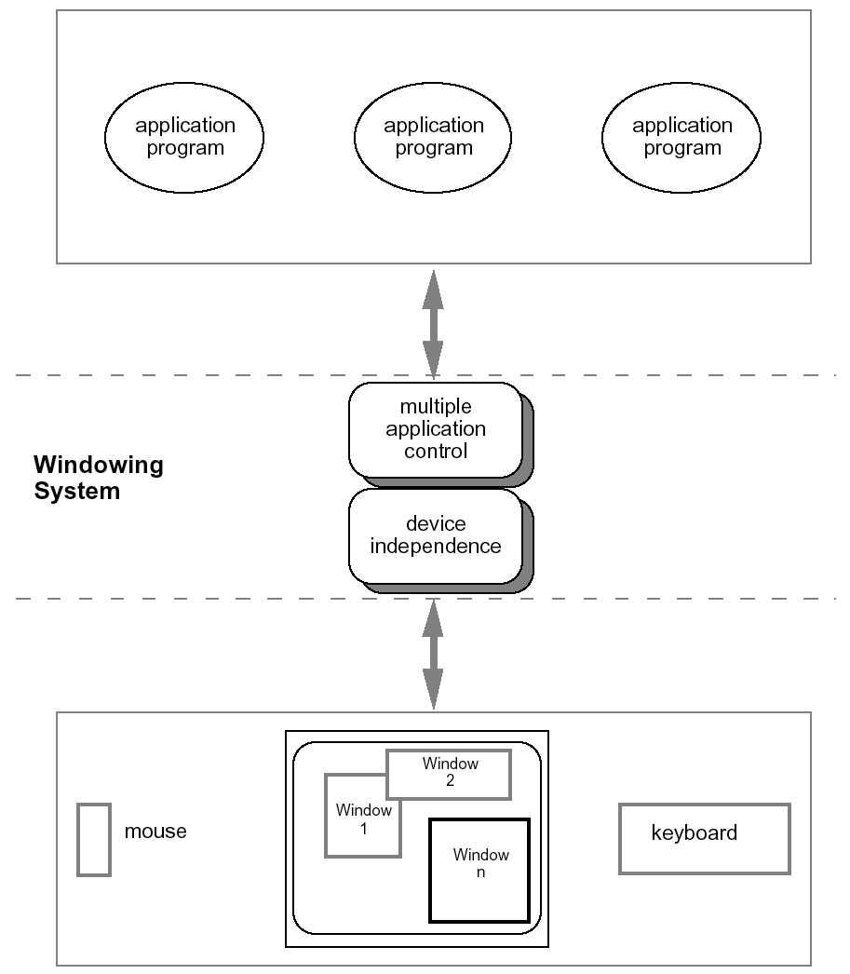
roles of a windowing system

Slide 22
Architectures of windowing systems
three possible software architectures
all assume device driver is separate
differ in how multiple application management is implemented
1. each application manages all processes
everyone worries about synchronization
reduces portability of applications
2. management role within kernel of operating system
applications tied to operating system
3. management role as separate application maximum portability

Slide 23
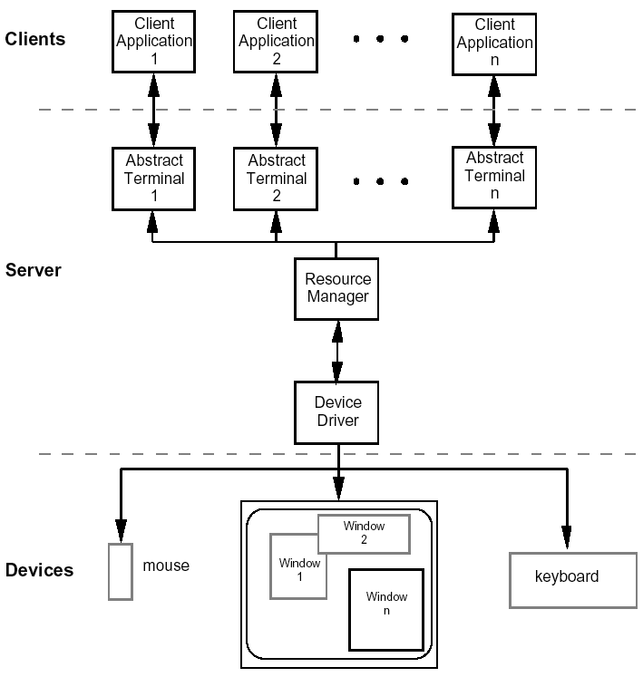
The client-server architecture

Slide 24
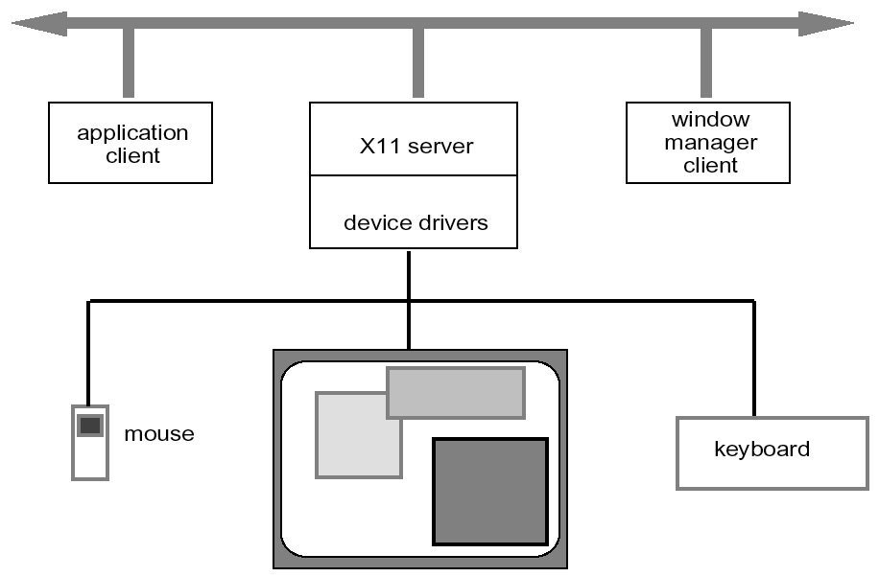
X Windows architecture

Slide 25
X Windows architecture (ctd)
pixel imaging model with some pointing mechanism
X protocol defines server-client communication
separate window manager client enforces policies for input/output:
how to change input focus
tiled vs. overlapping windows
inter-client data transfer

Slide 26
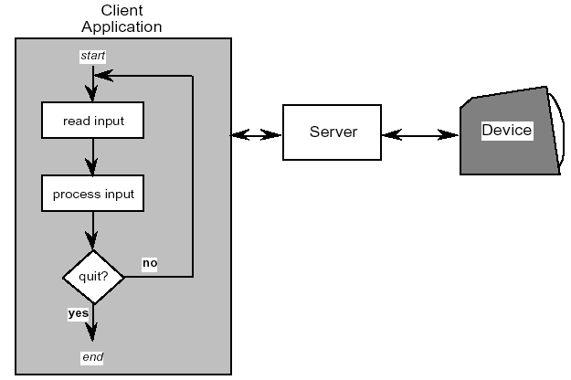
Programming the application - 1 read-evaluation loop
repeat
read-event(myevent)
case myevent.type
type_1:
do type_1 processing
type_2:
do type_2 processing
...
type_n:
do type_n processing
end case
end repeat

Slide 27
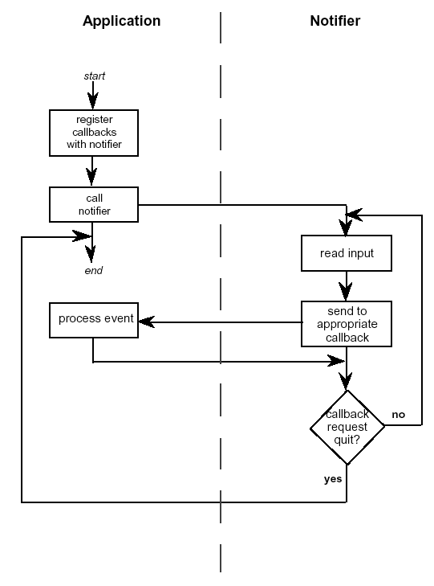
Programming the application - 1 notification-based
void main(String[] args) {
Menu menu = new Menu();
menu.setOption(“Save”);
menu.setOption(“Quit”);
menu.setAction(“Save”,mySave)
menu.setAction(“Quit”,myQuit)
...
}
int mySave(Event e) {
// save the current file
}
int myQuit(Event e) {
// close down
}

Slide 28
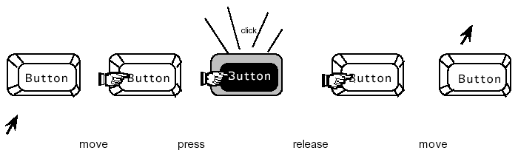
Using toolkits
Interaction objects
input and output intrinsically linked
Toolkits provide this level of abstraction
programming with interaction objects (or techniques, widgets, gadgets)
promote consistency and generalizability through similar look and feel
amenable to object-oriented programming
move
press
release
move

Slide 29
interfaces in Java
Java toolkit – AWT (abstract windowing toolkit)
Java classes for buttons, menus, etc.
Notification based;
AWT 1.0 – need to subclass basic widgets
AWT 1.1 and beyond -– callback objects
Swing toolkit
built on top of AWT – higher level features
uses MVC architecture (see later)
The Latest is JavaFX

Slide 30
User Interface Management Systems (UIMS)
UIMS add another level above toolkits
toolkits too difficult for non-programmers
concerns of UIMS
conceptual architecture
implementation techniques
support infrastructure
non-UIMS terms:
UI development system (UIDS)
UI development environment (UIDE)
e.g. Visual Basic

Slide 31
UIMS as conceptual architecture
Separation between application semantics and presentation
improves:
portability – runs on different systems
reusability – components reused cutting costs
multiple interfaces – accessing same functionality
customizability – by designer and user

Slide 32
UIMS tradition – interface layers / logical components
linguistic: lexical/syntactic/semantic
Seeheim:
Arch/Slinky

Slide 33
Seeheim model
lexical
syntactic
semantic
USER
Presentation
Dialogue
Control
Functionality
(application
interface)
USER
APPLICATION
switch

Slide 34
Conceptual vs. implementation
Seeheim
arose out of implementation experience
but principal contribution is conceptual
concepts part of ‘normal’ UI language
… because of Seeheim … … we think differently!
e.g. the lower box, the switch
needed for implementation
but not conceptual

Slide 35
Semantic feedback
different kinds of feedback:
lexical – movement of mouse
syntactic – menu highlights
semantic – sum of numbers changes
semantic feedback often slower
use rapid lexical/syntactic feedback
but may need rapid semantic feedback
freehand drawing
highlight trash can or folder when file dragged

Slide 36
What’s this?

Slide 37
The bypass/switch
direct communication between application and presentation
rapid semantic feedback
but regulated by
dialogue control

Slide 38
More layers! Arch/Slinky

Slide 39
Arch/Slinky
More layers! – distinguishes lexical/physical
Like a ‘slinky’ spring different layers may be thicker (more important) in different systems
or in different components

Slide 40
Monolithic vs. components
Seeheim has big components
often easier to use smaller ones
esp. if using object-oriented toolkits
Smalltalk used MVC – model–view–controller
model – internal logical state of component
view – how it is rendered on screen
controller – processes user input

Slide 41
MVC (model - view - controller)
view
model
controller

Slide 42
MVC issues
MVC is largely pipeline model:
input → control → model → view → output
But in graphical interface
input only has meaning in relation to output
e.g. mouse click
need to know what was clicked
controller has to decide what to do with click
but view knows what is shown where!
In practice controller ‘talks’ to view
separation not complete

Slide 43
PAC model
PAC model closer to Seeheim
abstraction – logical state of component
presentation – manages input and output
control – mediates between them
manages hierarchy and multiple views
control part of PAC objects communicate
PAC cleaner in many ways … but MVC used more in practice
(e.g. Java Swing)

Slide 44
PAC presentation - abstraction - control
A
P
A
P
C
C
abstraction
presentation
control
A
P
C
A
P
C

Slide 45
Implementation of UIMS
Techniques for dialogue controller
• menu networks • state transition diagrams
• grammar notations • event languages
• declarative languages • constraints
• graphical specification
N.B. constraints
instead of what happens say what should be true
used in groupware as well as single user interfaces
(ALV - abstraction–link–view)

Slide 46
Graphical specification
What it is
draw components on screen
set actions with script or links to program
In use
with raw programming most popular technique
e.g. Visual Basic, Dreamweaver, Flash
Local vs. global
hard to ‘see’ the paths through system
focus on what can be seen on one screen

Slide 47
Thank you!

